Slide 1
Document Browser for Blind
Group-V
Ankit Bagde (17CS30009)
Naimesh Pramanik (17CS30023)

Slide 2
About the project :
Blind or visually impaired people face a lot of difficulties while browsing internet. There is a need for such software which can be user-friendly to blind or visually impaired people so that they can browse without much difficulty.
This software is helpful for several classes of people ranging from partially blind to such people who are completely blind. Any visually impaired individual can browse internet with help of this software.
To be more precise, user can do “google search” by speaking and can navigate to a particular web page of google search. Finally, can hear different HTML attributes of a web page. Few number keys are used to give the input.

Slide 3
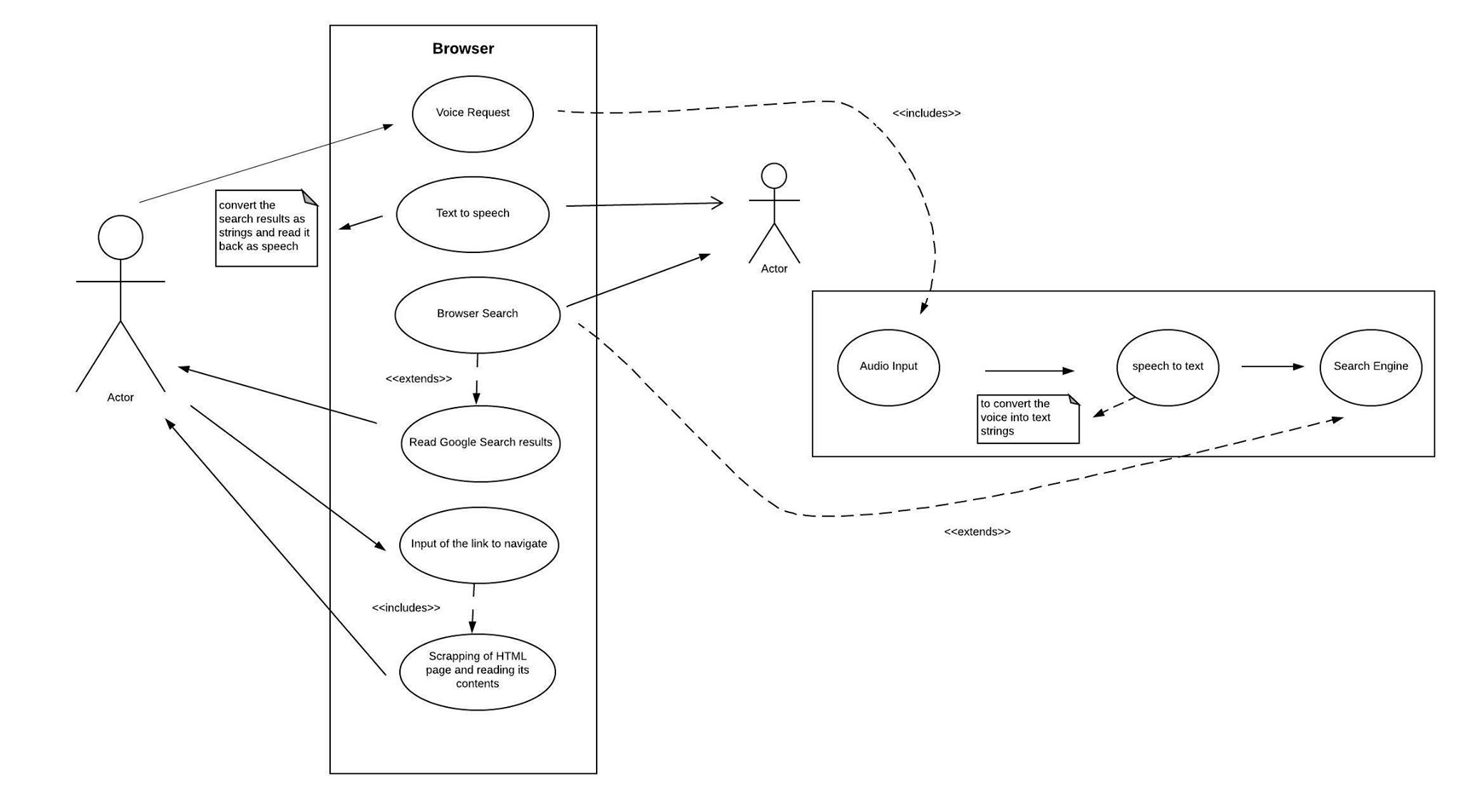
UML Diagram
UML Diagram

Slide 4
Environment used :
Backend - Flask(Python)
Frontend - HTML, Javascript, CSS, jQuery
Library used - gTTS, speech_recognition, bs4, urllib, html_table_extractor
Overall progress :
The assigned project has been completed by making a webapp, which may help blind to navigate through internet through use of minimum number of keys,

Slide 5
Challenges Faced/Overcomed:
Initially, we had a plan to append the backend work to a chrome extension, but while making the chrome extension , we faced much problem because of extensive coding of javascript required there. Finally we found a way out and did it by making a webapp.

Slide 6
Thank You!

